Slide 1
AWS Pricing Calculator
Let’s Estimate Price

Slide 2
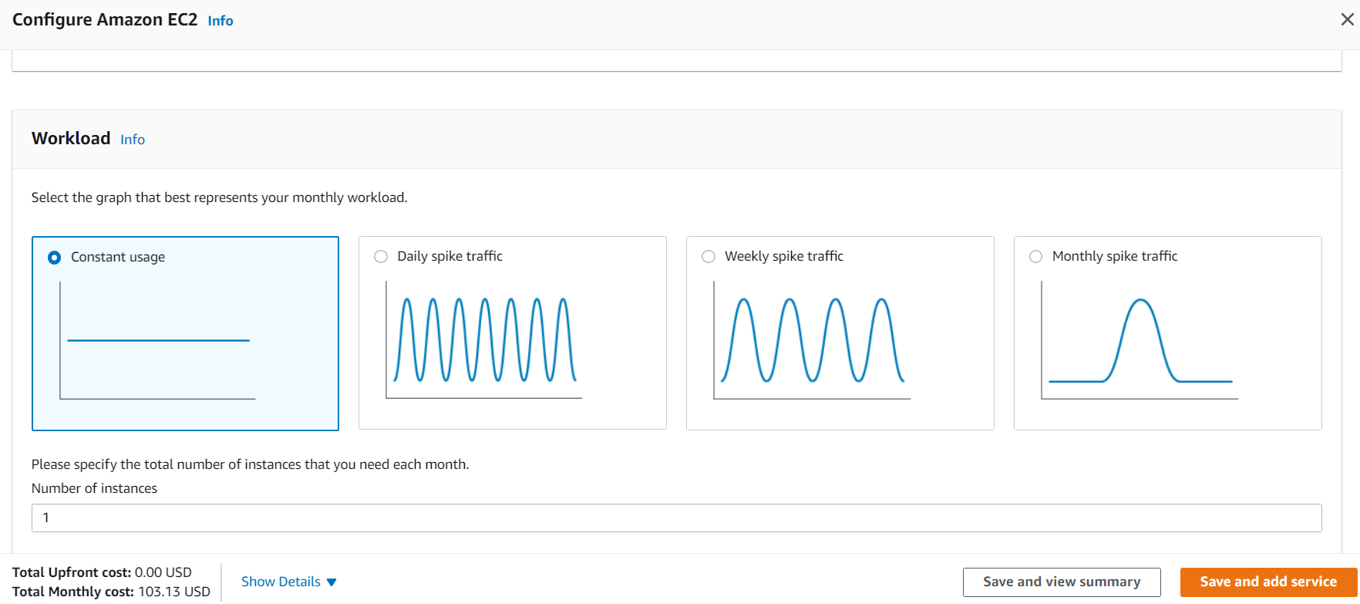
Basics of Pricing Calculator
AWS Pricing Calculator is a web-based planning tool that you can use to create estimates for your AWS use cases.
You can use it to help you plan how you spend, find cost saving opportunities, and make informed decisions when using Amazon Web Services.
knowledge portal

Slide 3
Well Architected Framework
Design Matters

Slide 4
Overview of the framework
The Well-Architected Framework has been developed to help cloud architects build secure, high-performing, resilient, and efficient infrastructure for their applications.
The framework is designed with five pillars in consideration, namely:
Operational Excellence
Security
Reliability
Performance Efficiency
Cost Optimization
knowledge portal

Slide 5
Pillar 1 : Operational Excellence
Focuses on running and monitoring systems so provide business value.
Design principles:
Perform operations as code.
Annotated Documentation
Make frequent ,small, reversible changes.
Refine Operations procedure frequently.
Anticipate failure.
Learn from operational failure.
knowledge portal

Slide 6
Pillar 2 : Security
Focuses on on protecting information & systems.
Design principles:
Implement a strong identity foundation.
Enable traceability
Apply security at all layers.
Automate security best practices.
Protect data in transit and at rest.
Keep people away from data.
Prepare for security events.
knowledge portal

Slide 7
Pillar 3 : Reliability
Focuses on the ability to prevent, and quickly recover from failures to meet business and customer demand.
Design principles:
Test Recovery Procedure.
Automatically recover from failure
Scale horizontally to increase aggregate system availability
Stop guessing capacity
Manage change in automation
knowledge portal

Slide 8
Pillar 4 : Performance Efficiency
Focuses on using IT and computing resources efficiently.
Design principles:
Democratize advanced technologies
Go global in minutes
Use serverless architectures
Experiment more often
Mechanical sympathy
knowledge portal

Slide 9
Pillar 5 : Cost Optimization
Focuses on avoiding un-needed costs.
Design principles:
Adopt a consumption model
Measure overall efficiency
Stop spending money on data center operations
Analyze and attribute expenditure
Anticipate failure.
Use managed services to reduce cost of ownership
knowledge portal

Slide 10
AWS Personal Health Dashboard
Health Check is Important

Slide 11
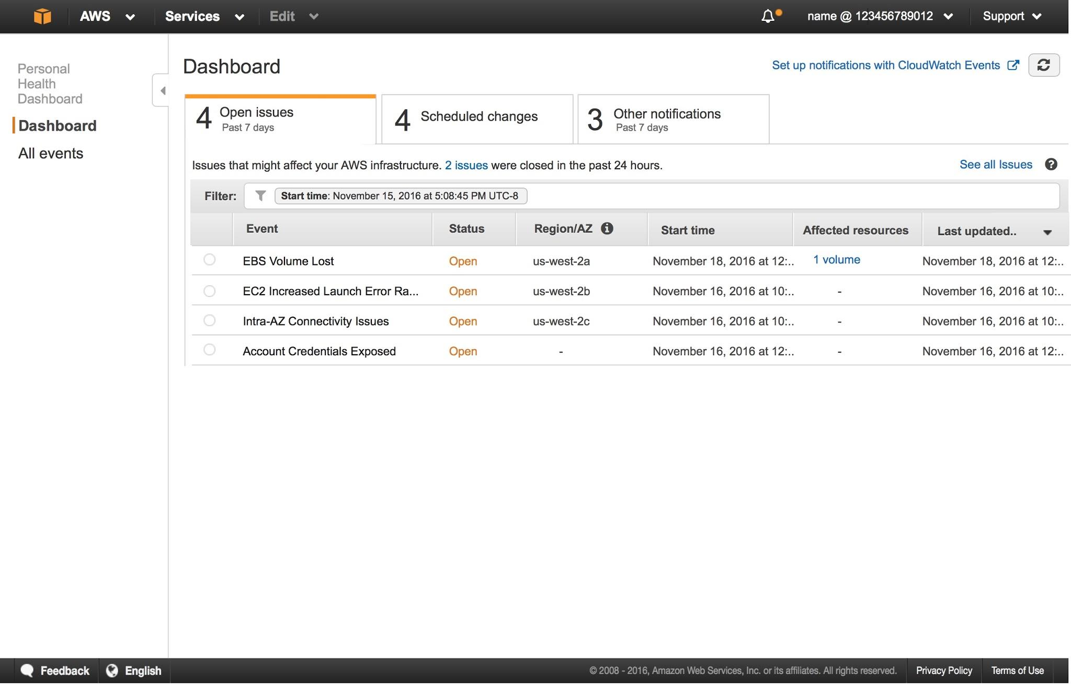
Overview of Personal Health Dashboard
AWS Personal Health Dashboard displays issues that are impacting your resources or potentially impacting services that you use for your AWS
It can be scheduled activities related to infrastructure powering your resources.
knowledge portal

Slide 12
EC2 Pricing
Cost Optimization

Slide 13
Paying for EC2 Instances
There are fives primary ways in which we can pay for EC2 instance usage.
On-Demand
Savings Plan
Reserved Instances
Spot Instances
Dedicated Hosts
knowledge portal

Slide 14

On-Demand Pricing
With On-demand instances, we pay for compute capacity per hour or per second depending on the instances which is being run.
No upfronts payments are needed and we can increase or decrease the capacity whenever it is needed.
knowledge portal

Slide 15
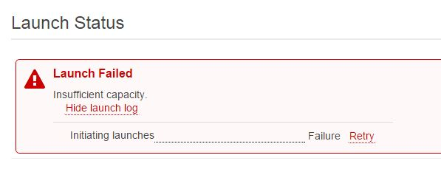
On-Demand Can Lead to Unexpected Issues
Monday: 500 customers using 16GB RAM on-demand servers individually.
Wednesday: 30 customers using 16GB RAM on-demand servers individually.
A “Cloud Service Provider” will not have a clear picture on how many servers should the provision. Too high → resources might unused and too low → money loss
knowledge portal

Slide 16
Reserved Instance
Reserved Instance provides us with significant discount (upto 75%) compared to on-demand instance pricing.
Reserved instance are assigned to a specific availability zone and provides capacity reservation for AWS EC2 instances.
Example :
You know you will always be running 20 servers of m4.2xlarge type of 1 year, then buy reserved instances for them.
knowledge portal

Slide 17
Reserved Instance - Part 2
Example: g4dn.8xlarge instance type
Pricing Option | Hourly Cost | Total 3 year cost
On-Demand Instance | $2.176 | $57,276
3 year all up-front - Reserved | - | $21502
Savings |  | ~62%
knowledge portal

Slide 18

Spot Instance
Spot instances allows us to bid on spare Amazon EC2 computing capacity for up to 90% of the on-demand cost.
Such instances are recommended for applications that can have flexible start and end times
knowledge portal

Slide 19
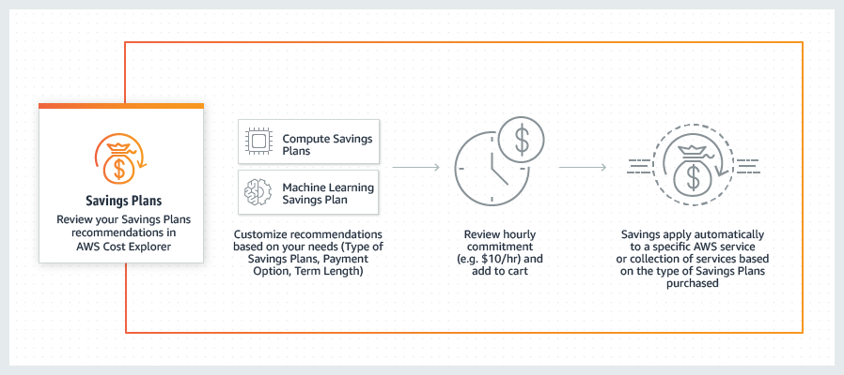
Savings Plans
Savings Plans are a flexible pricing model that offer low prices on EC2 and Fargate usage, in exchange for a commitment to a consistent amount of usage (measured in $/hour) for a 1 or 3 year term.
knowledge portal

Slide 20

Dedicated Host
A dedicated host is a physical EC2 server dedicated for your use.
It can be purchased on-demand as well as reserved instance.
knowledge portal

Slide 21
AWS Support Plans
Little support is always beneficial

Slide 22

Understanding AWS Support
AWS Support is one of the most direct ways in which customers can interact with the AWS cloud support engineers to understand, troubleshoot their problems.
It is for those who are :
Experimenting with AWS
Production use of AWS
Business Critical use of AWS
knowledge portal

Slide 23
Support Plans
There are four major types of AWS Support Plans:
Basic
Developer
Business
Enterprise
Depending on the type of use-case, workloads and criticality of application you are running, an organization can choose to go with any of the above plans.
knowledge portal

Slide 24
AWS Organizations
Centralized Control

Slide 25
Getting the basics right
AWS offers centralized policy-based management as well as the feature of consolidated billing for multiple AWS accounts through the feature of AWS Organizations.
AWS Organizations
Policies
Consolidated Billing
knowledge portal

Slide 26
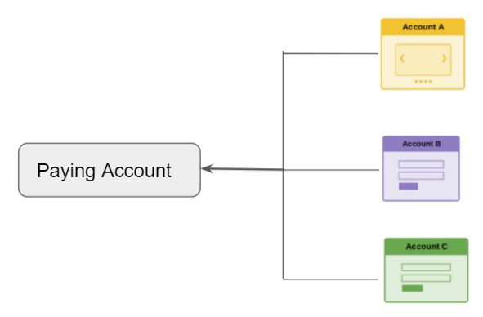
Part 1 - Consolidated Billing
In consolidated billing, management account to access the billing information and pay for all member accounts.
knowledge portal

Slide 27

Part 2 - Policies
Policies in AWS Organizations enable you to apply additional types of management to the AWS accounts in your organizations.
Deny Disable CloudTrail
AWS Account A
AWS Organization
AWS Account B
Deny ALL S3
knowledge portal

Slide 28
AWS Marketplace
Let’s Launch

Slide 29
Overview of AWS Marketplace
AWS Marketplace is a catalog with thousands of software listing from software vendors which makes it easy for customers to deploy solutions in AWS.
Let’s understand with an example:
Organization needs Solution X (Anti-Virus) to be running in next 3 days.
John has identified the vendor but he needs to configure the Linux server with all prerequisites, install the solution and modify it’s configuration file for optimization.
This will lead to more amount of time.
knowledge portal

Slide 30

Advantage of AWS Marketplace
2nd Advantage of AWS Marketplace - Pay As You Use
For Example:
Nginx Plus is a commercial solution.
You want to use it for 10 days.
You can launch Nginx Plus from AWS Marketplace for 10 days and terminate instance later.
You get charged for 10 days.
knowledge portal

Slide 31
Cost Explorer
AWS Cost Optimization

Slide 32
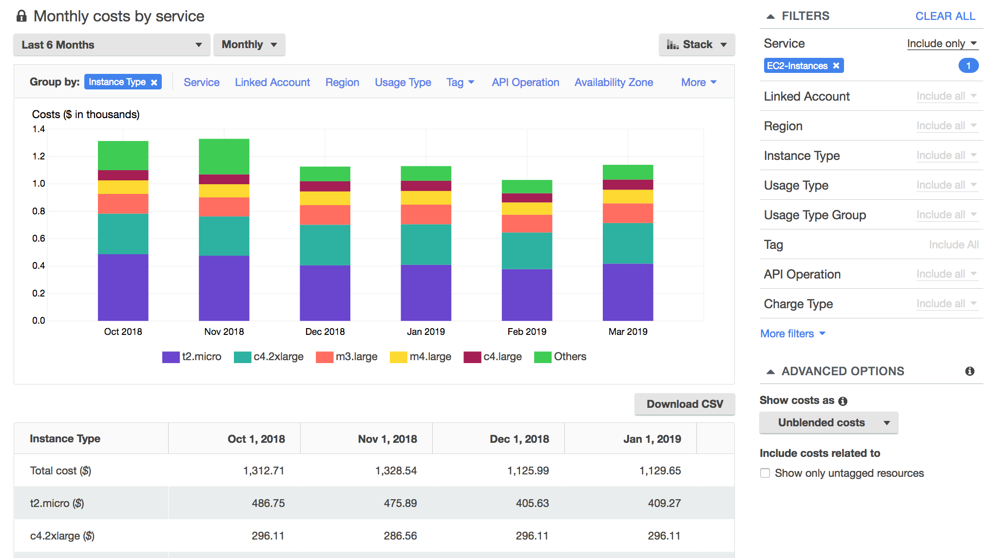
Overview of AWS Cost Explorer
AWS Cost Explorer has an easy-to-use interface that lets you visualize, understand, and manage your AWS costs and usage over time.
knowledge portal

Slide 33
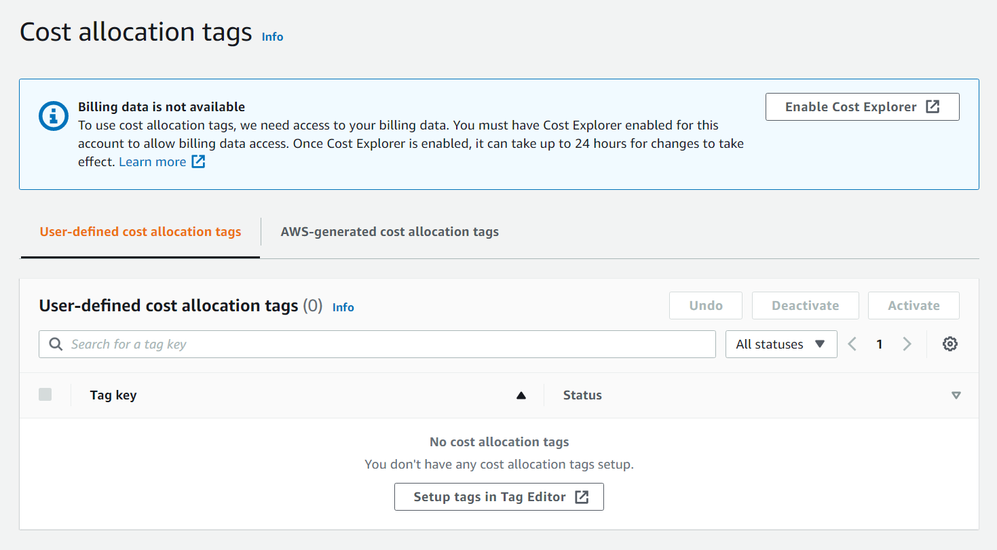
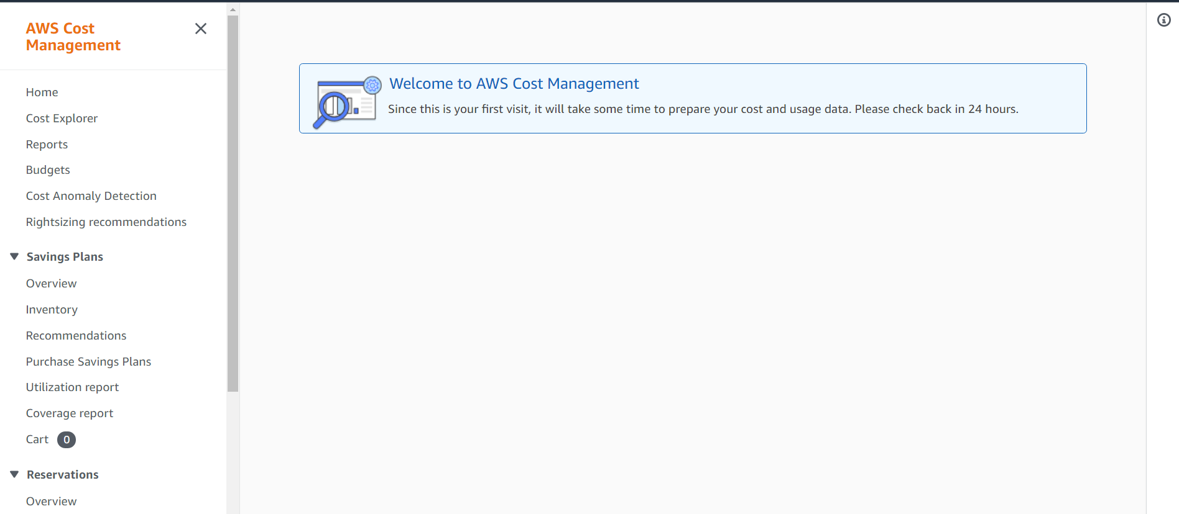
Enabling Cost Explorer
AWS Cost Explorer is not enabled by default and you will have to explicitly enable it from the Billing console
knowledge portal

Slide 34
Reserved Instances
Money Optimization

Slide 35
Types of Reserved Instances
Type of RIs | Description
Standard RIs | These provide the most significant discount (up to 72% off On-Demand) and are best suited for steady-state usage.
Convertible RIs | These provide a discount (up to 54% off On-Demand) and the capability to change the attributes of the RI
Scheduled RIs | These are available to launch within the time windows you reserve.
knowledge portal

Slide 36
RI Types
With convertible RI, we can :
Convert to new instance family eg R3 to M4 to C4 to T2
Convert to new operating system eg Windows to Linux
Convert to new instance price [ eg if AWS reduces the public rate for our instance ]
Convert to new instance size [ eg : from m4.xlarge to m4.2xlarge ]
Convert tenancy [ eg dedicated instance to default ]
Convert to different payment option [ no upfront to partial upfront ]
knowledge portal

Slide 37
Reservation Term
Reservation Term | Description
No Upfront | No upfront required. Lower discount rate compared to others.
Partial Upfront | You make a low upfront payment and are then charged a discounted hourly rate for the instance for the duration of the Reserved Instance term.
All Upfront | You pay for the entire Reserved Instance term with one upfront payment. Provides the largest discount.
knowledge portal

Slide 38
Regional vs Zonal RIs
 | Regional RI | Zonal RI
Ability to Reserve Capacity | No Reservation in Capacity. | Capacity Reserved in the specific Availability Zone.
Availability Zone Flexibility | The Reserved Instance discount applies to instance usage in any Availability Zone in the specified Region. | Reserved Instance discount applies to instance usage in the specified Availability Zone only.
Instance size flexibility | The Reserved Instance discount applies to instance usage within the instance family, regardless of size. | No instance size flexibility—the Reserved Instance discount applies to instance usage for the specified instance type and size only.
knowledge portal

Slide 39
Scenario
Scenario 1 :
Customer has following instances running:
2 x m4.large instance running in us-east-1a and us-east-1b region.
2 x t2.large instance running across us-east-1b and us-east-1c region
Customer has following RI:
2 x m4.large, default tenancy, us-east-1b region (zonal RI)
2 x t2.large, default tenancy, us-east-1 regional RI
Additional pay : 1 x m4.large instance will be charged at the on-demand rate.
knowledge portal

Slide 40
Business Intelligence
ETL and Visualization

Slide 41

Business Intelligence
Business Intelligence comprises of data, technology, analytics and human intelligence to provide insights that results in more successfully business outcome.
Typical questions
Number of pageviews for course
Country / Region information.
Traffic Origin (google, emails)
Device (mobile, laptop, tablets)
Video Courses
Users
knowledge portal

Slide 42





Extract Transform Load
ETL is a data integration process that combines data from multiple data sources into a single, consistent data store that is loaded into a data warehouse or other target system.
CloudFront
RDS
S3 Bucket
AWS Glue
New S3 Bucket
EC2
ETL Tool

Slide 43
Sample Data Normalization
Mister Bob will be written as Mr. Bob.
902-957-8503-1021 will be written as 90295785031021
ip-172-31-24-230 will be written as 172.31.24.230
28Aug1991 will be written as 28/08/1991
knowledge portal

Slide 44
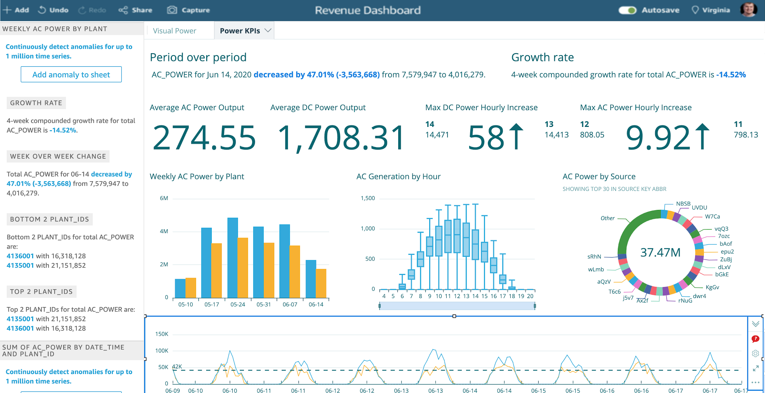
Overview of Amazon Quicksight
Amazon QuickSight is a scalable, serverless, machine learning-powered business intelligence (BI) service built for the cloud
New S3 Bucket
knowledge portal

Slide 45
X-Ray
Debugging & Monitoring Applications

Slide 46
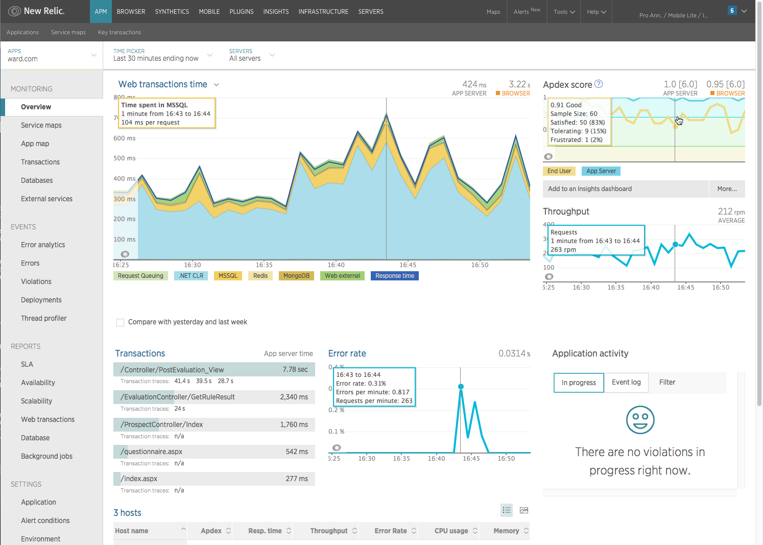
Traditional APM
knowledge portal

Slide 47
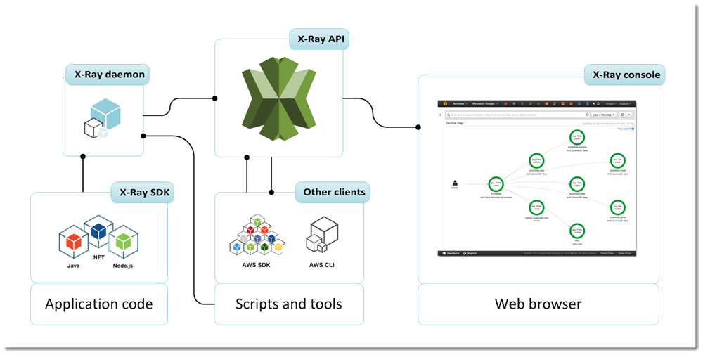
Overview of X-Ray
AWS X-Ray allows us to debug our applications with functionality of request tracing so we can find the root cause and performance issues.
knowledge portal

Slide 48
X-Ray Integration
AWS X-Ray provides integration with various AWS services like:
AWS EC2
Lambda
Elastic Load Balancing
API Gateway
Elastic Beanstalk
knowledge portal

Slide 49
X-Ray Supported Platform
AWS X-Ray provides support for following platforms:
Java
Go
.NET
Ruby
Python
Node JS
knowledge portal

Slide 50
AWS License Manager
Let’s understand Licensing

Slide 51
Getting Started
In Enterprises, managing software licenses sometimes becomes quite a hassle.
Organizations uses wide variety of software licenses:
OS Level Licenses : Windows, RedHat
Database Licenses : Oracle DB, Microsoft SQL
Application Licenses: SAP
Other 3rd Party Licenses
knowledge portal

Slide 52
Challenges
In Cloud, new servers can be launched in click of a button.
License Violation detected during audit can lead to heavy penalties.
Difficult to track licenses across multiple accounts.
knowledge portal

Slide 53

Overview of AWS License Manager
AWS License Manager is a service which allows us to manage license from wide variety of software vendors across AWS and on-premise.
We can enforce policies for licenses based on various factors like CPU, sockets that will control the number of EC2 instance which can be launched.
Launch 2 EC2 from RedHat 9
AWS
Nope. We only have 1 EC2 license
knowledge portal

Slide 54
Consolidated Billing
Money Optimization

Slide 55

Many AWS Accounts
Lots of organizations are following approach of having multiple AWS accounts.
For example, separate AWS account for DEV, Staging, Production.
It brings quiet lot of benefits which includes security as well as costing.
knowledge portal

Slide 56
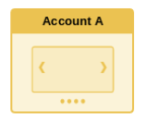
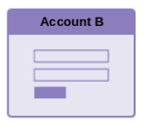
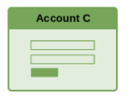
What many startups do ?
A startup has 3 AWS accounts which they use to separate their environment as part of good security best practice. At end of the month, they get 3 separate bills and they pay for each and every account individually.
knowledge portal

Slide 57
Consolidated Billing
We need to link all our AWS accounts with the central paying account through AWS Organizations.
Paying Account
knowledge portal

Slide 58
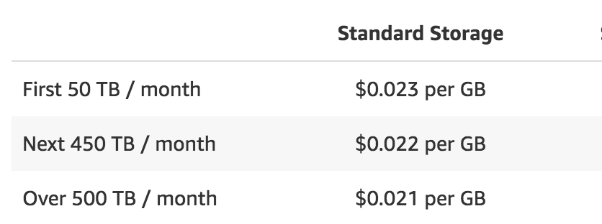
Benefits
There are a lot of benefits of consolidated billing :
One bill per linked AWS account.
It becomes quite easy to allocate costing and budgets.
Benefits of volume pricing discounts.
Benefits when using reserved instances as well.
knowledge portal

Slide 59
Reserved Instance Benefits
DEV Account: Running 6 on-demand instances
Paying Account
Prod Account: Has 6 RI and running 3 instances
Total Bill : We will be billed for 6 RI and only 3 on-demand instances.
knowledge portal

Slide 60

Important Pointers & Best Practices
Paying account should be used for billing purpose only. Do not deploy resource there.
By default, we can have maximum of 20 linked accounts.
Even when linked, paying account is individual and does not have access on resources of the other accounts.
knowledge portal

Slide 61


Join us in our Adventure
kplabs.in/twitter
Be Awesome
kplabs.in/linkedin
instructors@kplabs.in

